Slide 1
Digital Portfolio
STUDENT NAME:Praveesh. E. s
REGISTER NO AND NMID: asbruce2428C0558
DEPARTMENT: BSc.AI&ML
COLLEGE: JCT COLLEGE OF ARTS AND SCIENCE

Slide 2
Praveesh. e. s
portfolio

Slide 3


AGENDA
Problem Statement
Project Overview
End Users
Tools and Technologies
Portfolio design and Layout
Features and Functionality
Results and Screenshots
Conclusion
Github Link
3/21/2024 Annual Review

Slide 4

PROBLEM STATEMENT
Create a simple personal portfolio webpage that dynamically displays different sections (About, Projects, Contact) without reloading the page.
The webpage should:
Have a clean and professional design.
Include a header with the user’s name.
Feature a navigation bar with three buttons: About, Projects, and Contact.
Display content relevant to the selected section inside the main content area.
Update the displayed content dynamically when a navigation button is clicked, without reloading the page.
Highlight or indicate the currently active section (optional for better UX).
Include a footer with copyright information.
The goal is to provide an easy-to-navigate, single-page portfolio that showcases the user's information and work clearly and efficiently.

Slide 5

PROJECT OVERVIEW
Project Overview
This project is a Simple Portfolio Website designed to showcase the personal and professional profile of an individual, such as a web developer. The site provides a clean, modern, and responsive interface that allows visitors to navigate through key sections—About, Projects, and Contact—without page reloads.
The primary objective is to create a smooth user experience by dynamically loading content based on user interaction with navigation buttons. The website highlights the individual’s skills, previous work, and contact information, making it an effective tool for personal branding and professional outreach.
Key Features:
Responsive layout optimized for desktop and mobile devices.
Dynamic content switching between sections using JavaScript.
Clear navigation with three main sections.
Aesthetic design with consistent color scheme and typography.
Footer with copyright notice.
This portfolio aims to serve as a straightforward yet impactful representation of the individual’s capabilities and contact details, helping to engage potential clients, employers, or collaborators.

Slide 6

WHO ARE THE END USERS?
End Users
Potential Employers / Recruiters People looking to hire a web developer or designer. They want to quickly learn about your skills, see examples of your projects, and find your contact information to reach out for job opportunities.
Clients / Prospective Clients Individuals or businesses interested in hiring freelance or contract services. They need to evaluate your experience and past work to decide if you’re the right fit for their project.
Collaborators / Peers Other developers, designers, or professionals who want to connect, collaborate, or exchange ideas. They may want to learn about your expertise and contact you for networking purposes.
Personal Contacts / Friends Friends, family, or acquaintances who want to see your professional work or share your portfolio with others.

Slide 7

TOOLS AND TECHNIQUES
Tools and Techniques
Tools
HTML5 Used for structuring the content of the webpage, defining sections like header, navigation, main content, and footer.
CSS3 Used for styling the webpage, including layout, colors, typography, spacing, and responsiveness.
JavaScript (Vanilla JS) Handles the dynamic content switching based on user interaction without reloading the page.
Code Editor (e.g., VS Code, Sublime Text) Used to write and edit the code efficiently.
Web Browser (e.g., Chrome, Firefox) For testing and previewing the website during development.
Version Control (Optional) (e.g., Git, GitHub) To manage changes and collaborate on code if needed.
Techniques
DOM Manipulation Using JavaScript to dynamically update the content inside the main container based on button clicks.
Event Handling Adding event listeners to navigation buttons to trigger content updates.
Responsive Web Design Although minimal in your current code, it involves using flexible layouts and media queries to ensure the site works well on different devices.
Progressive Enhancement Building a basic functional site first, then adding JavaScript to improve user experience without breaking core functionality.
Separation of Concerns Keeping HTML for structure, CSS for presentation, and JavaScript for behavior separated and organized.

Slide 8
POTFOLIO DESIGN AND LAYOUT
1. Overall Structure
The portfolio follows a single-page layout with distinct sections dynamically loaded into the main content area.
It uses semantic HTML elements:
<header> for the site title.
<nav> for navigation buttons.
<main> for the dynamic content area.
<footer> for copyright.
2. Header
Positioned at the top with a full-width blue background (#4a90e2).
Displays the user’s name prominently in white text, centered horizontally.
Provides immediate branding and identity.
3. Navigation Bar
A horizontal bar beneath the header with a dark background (#333).
Contains three buttons: About, Projects, and Contact.
Buttons have no default borders or backgrounds to keep the design minimal.
On hover, buttons get a subtle dark grey background (#555) for visual feedback.
Buttons use white text for contrast and readability.
8

Slide 9
FEATURES AND FUNCTIONALITY
1. Dynamic Content Loading
Content inside the main section updates dynamically based on which navigation button is clicked (About, Projects, Contact).
No page reload required — improves user experience by keeping navigation seamless and fast.
2. Navigation Bar
Three clear navigation buttons allow users to switch between the main portfolio sections.
Buttons respond visually to mouse hover for better interactivity.
3. Responsive Layout Basics
The site includes a viewport meta tag to enable scaling on different device widths.
Content container has a max-width and centered alignment to maintain readability on large and small screens.
4. Clean and Readable Design
Consistent use of typography, colors, and spacing to ensure the content is easily readable and aesthetically pleasing.
Sections have clear headings to organize information logically.

Slide 10
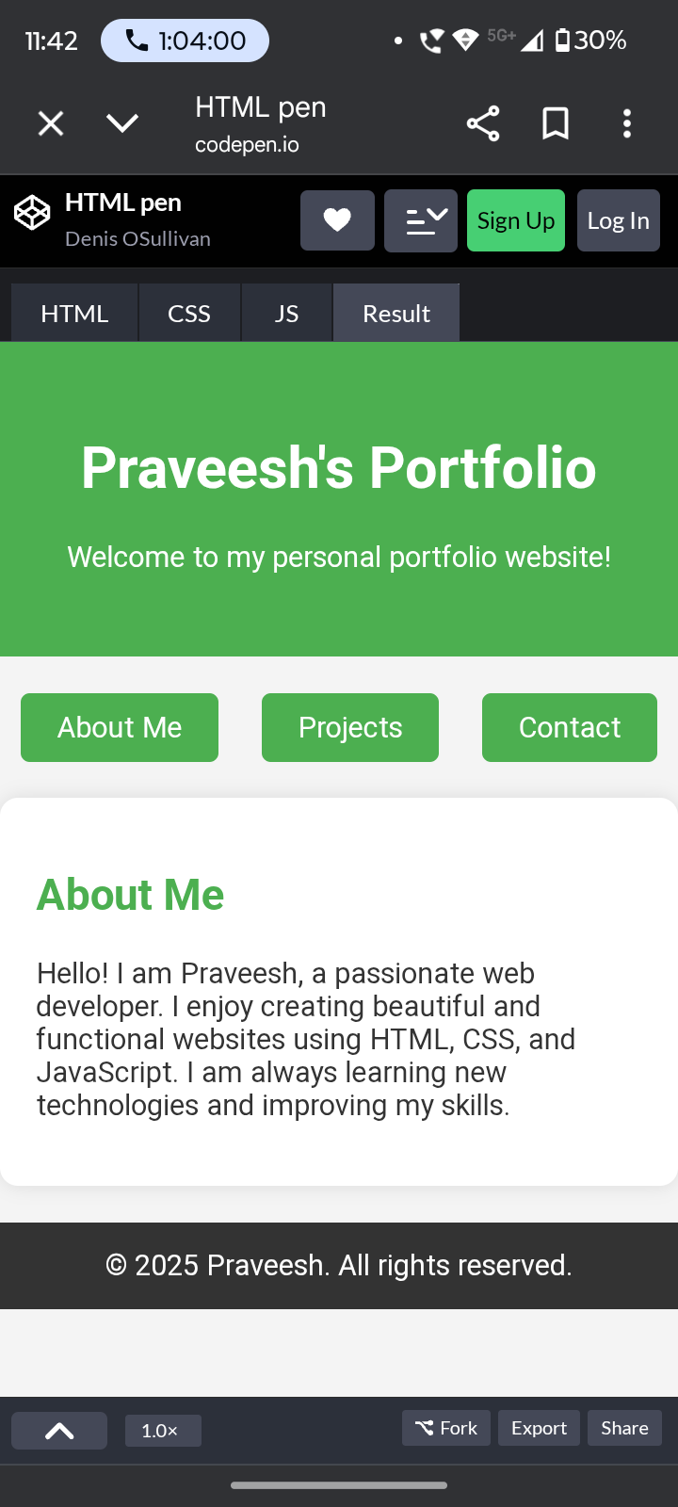

RESULTS AND SCREENSHOTS
3/21/2024 Annual Review
10

Slide 11
CONCLUSION
The Simple Portfolio Website successfully fulfills its purpose of providing a clean, easy-to-navigate platform to showcase personal skills, projects, and contact information. By using semantic HTML, CSS for styling, and JavaScript for dynamic content updates, the site offers a smooth user experience without the need for page reloads.
The design is professional and user-friendly, with a responsive layout that adapts to different screen sizes. While the project currently covers the essential features, there is room for future enhancements like improved accessibility, active navigation indicators, and more interactive elements.
Overall, this portfolio serves as an effective tool for personal branding, helping users present themselves clearly to potential employers, clients, and collaborators.
11

Slide 12
GitHub link
https://github.com/praveeshes97-web/Nm.git

